Slide 1


Final Presentation
CLECKSHOPHUB

Slide 2







Meet our team
Abhishek Poudel
Plant
Shasank Shrestha
Amulya Shrestha
Co-Ordinator
Resource Investigator
Soya Shrestha
Team Worker
Biliyas Maharjan
Team Worker
Sushan Bhandari
Implementer
Biraj Shrestha
Co-Ordinator

Slide 3

TABLE OF CONTENT
Initiation Phase
Team Contract
Project Charter
Planning Phase
Belbin Analysis
Skill Audit
MS Project
Communication Tools
Execution Phase
Database Design
Use Case Diagram
Website Demonstration
Customer Interface
Trader Interface
Admin Interface
3

Slide 4

INITIATION PHASE
Project Charter
Team Contract
4

Slide 5
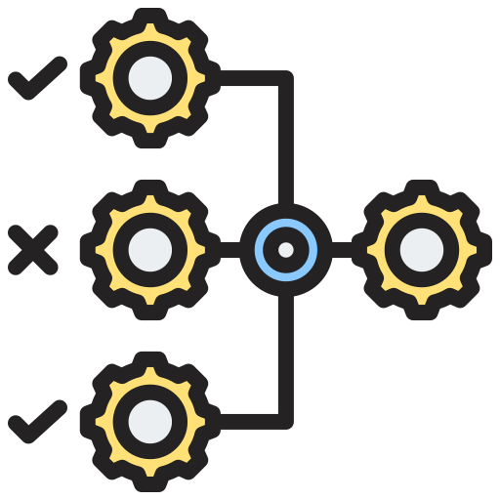











PROJECT CHARTER
TEAM CONTRACT
Version Control
Team Structure
Project Justification
Team Procedure
Project Scope
Team Participation
Estimated Budget
Personal Accountability
Consequences of breach of contract
Duration
Certification by team members
Roles and Responsibility

Slide 6
PLANNING PHASE
Belbin Analysis
MS Project

Slide 7
Belbin Analysis
Team Members | Primary Role | Secondary Role | Least likely Role
Abhishek Poudel | Plant | Resource Investigator | Shaper
Amulya Shrestha | Resource Investigator | Plant | Shaper
Biliyas Maharjan | Team Worker | Implementer | Monitor Evaluator
Biraj Shrestha | Co-Ordinator | Complete Finisher | Plant
Shasank Shrestha | Co-Ordinator | Specialist | Complete Finisher
Soya Shrestha | Team Worker | Monitor Evaluator | Shaper
Sushan Bhandari | Implemeter | Co-Ordinator | Specialist

Slide 8





MS PROJECT
TIMELINE
RESOURCE SHEET
TASK SHEET
GANTT CHART
CALENDAR

Slide 9
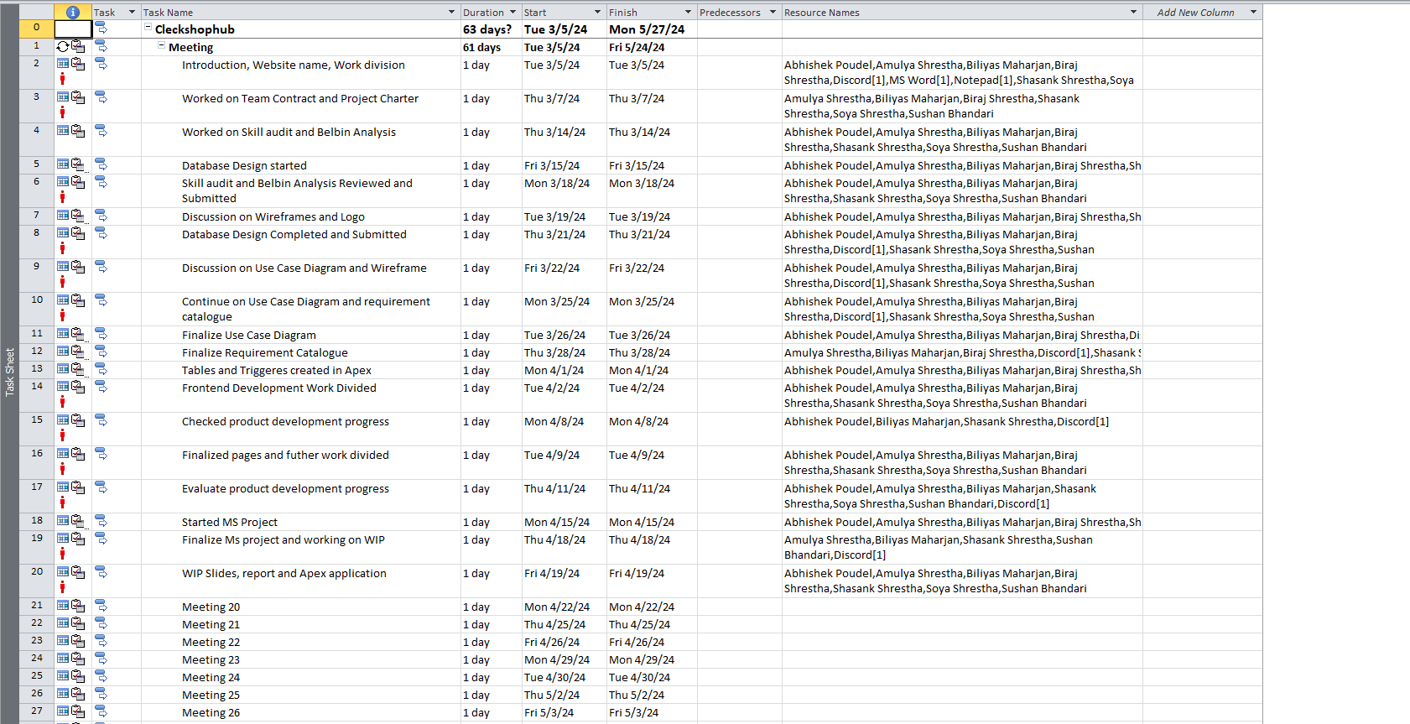
TASK SHEET
9

Slide 10
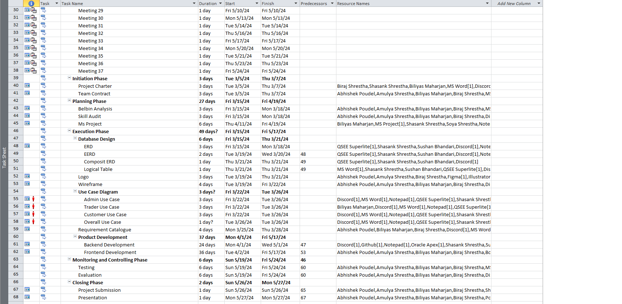
TASK SHEET
10

Slide 11
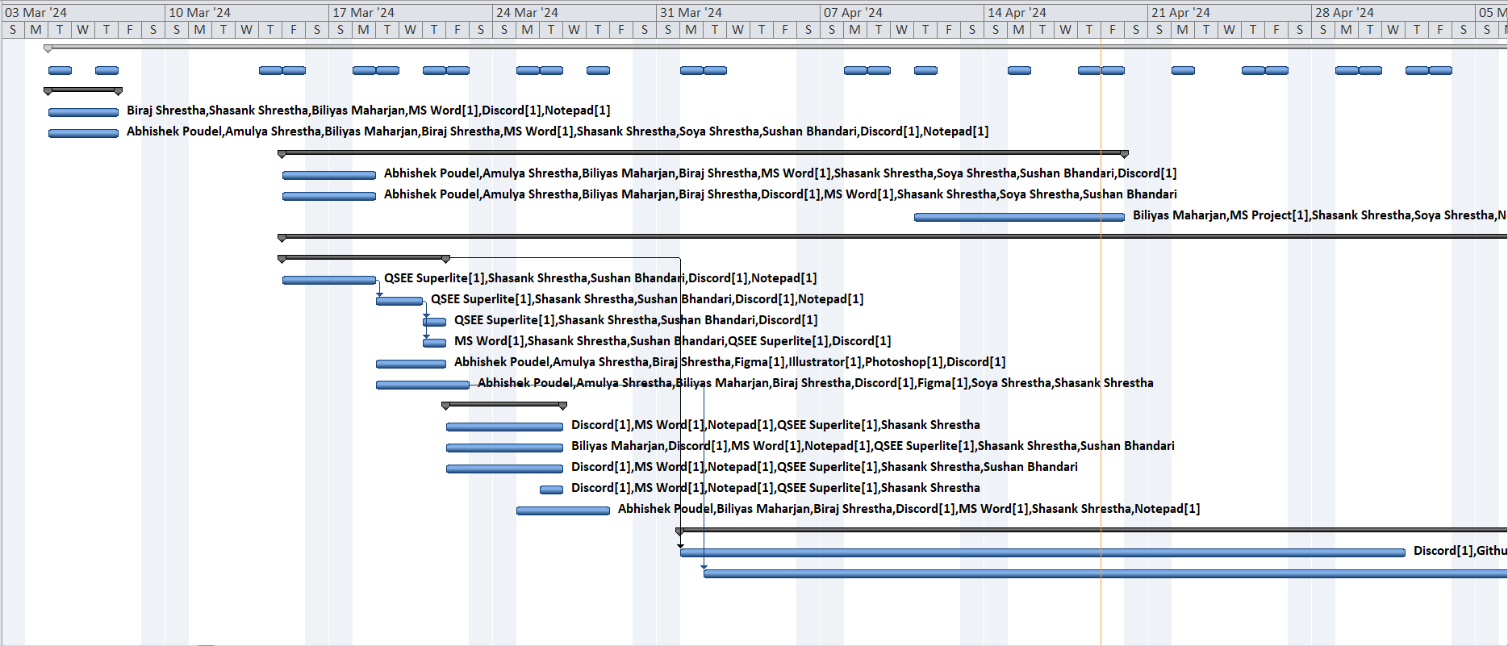
GANTT CHART
11

Slide 12
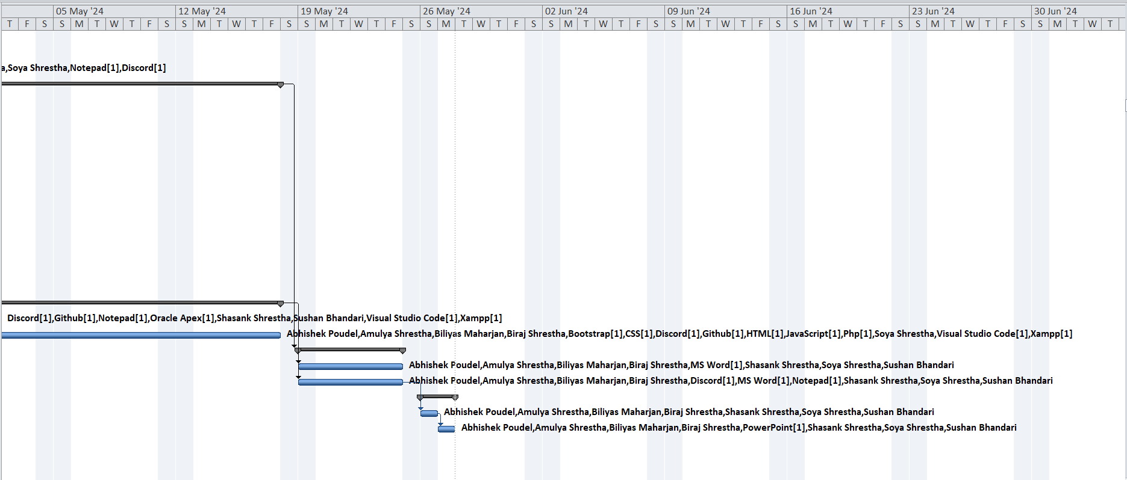
GANTT CHART
12

Slide 13
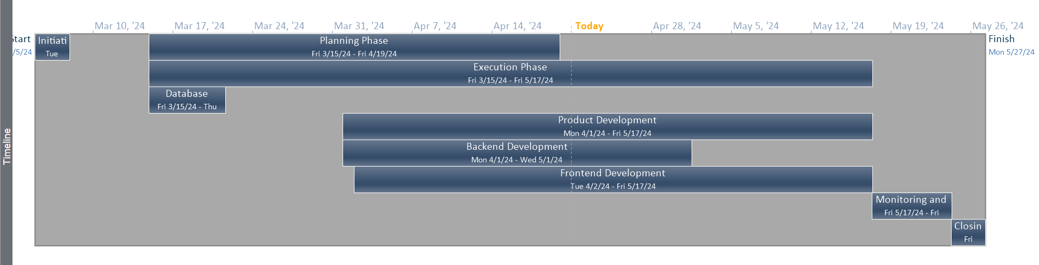
TIMELINE
13

Slide 14
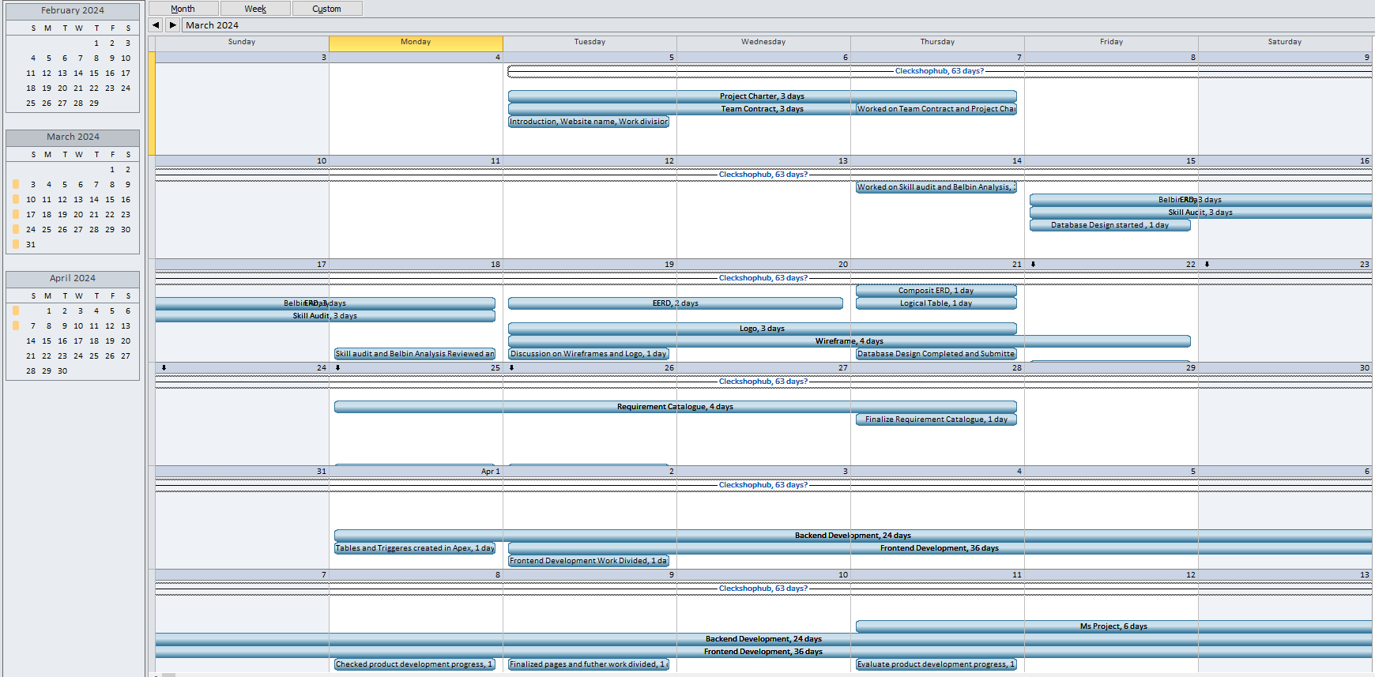
CALENDAR
14

Slide 15
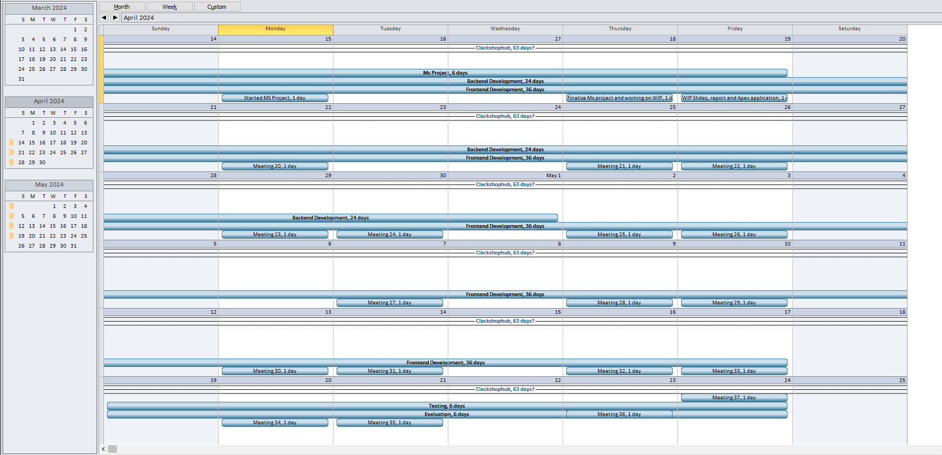
CALENDAR
15

Slide 16
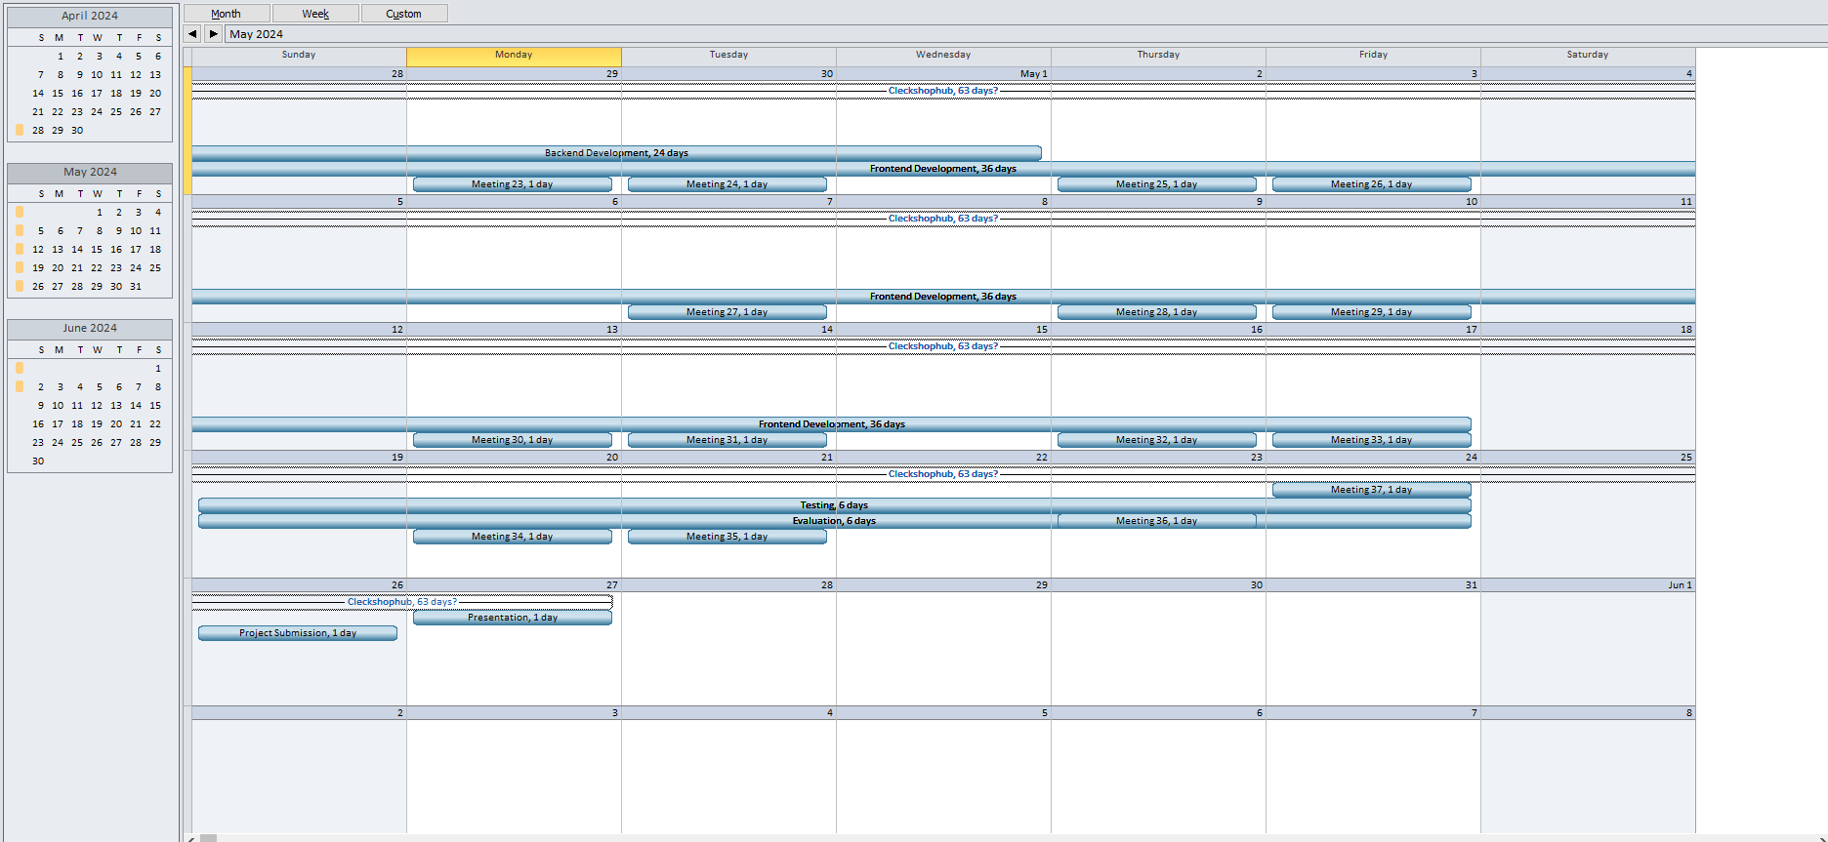
CALENDAR
16

Slide 17
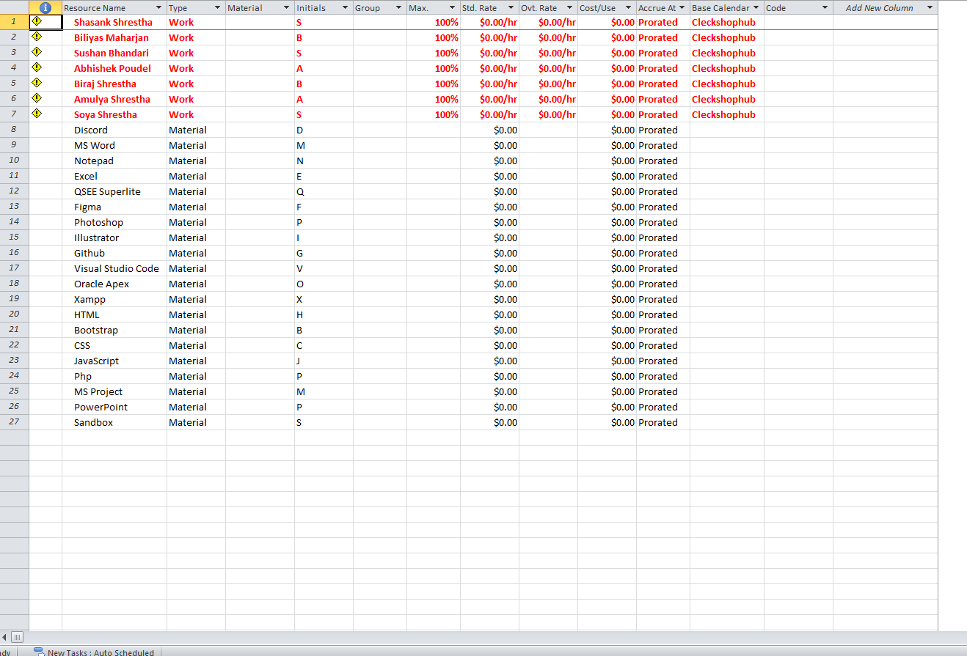
RESOURCE SHEET
17

Slide 18
EXECUTION PHASE
Database Design
Use Case Diagram

Slide 19
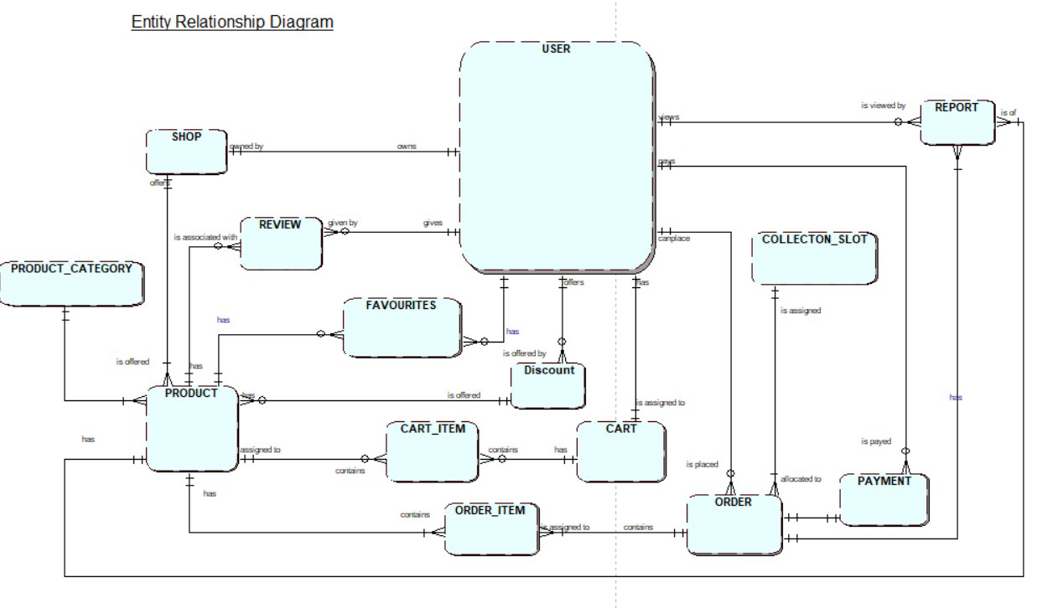
ERD

Slide 20
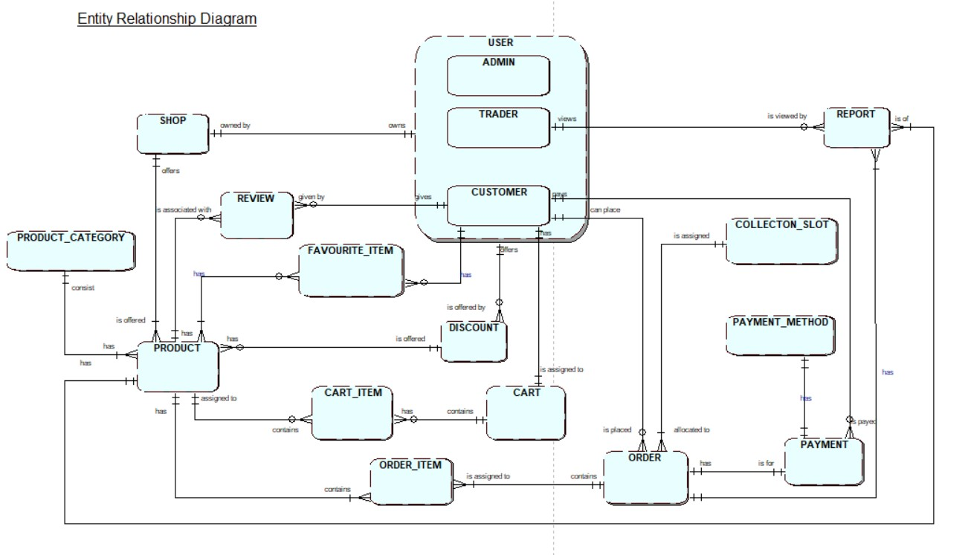
EERD

Slide 21
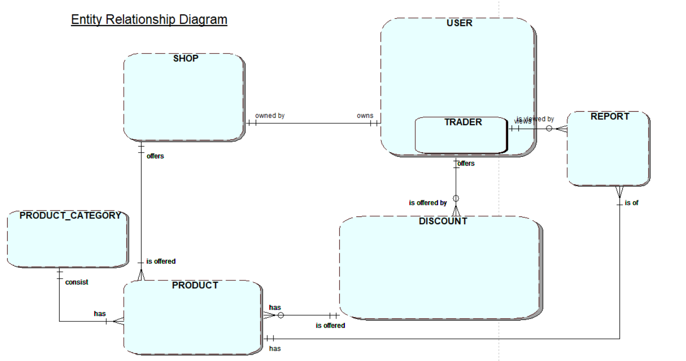
TRADER RELATION

Slide 22
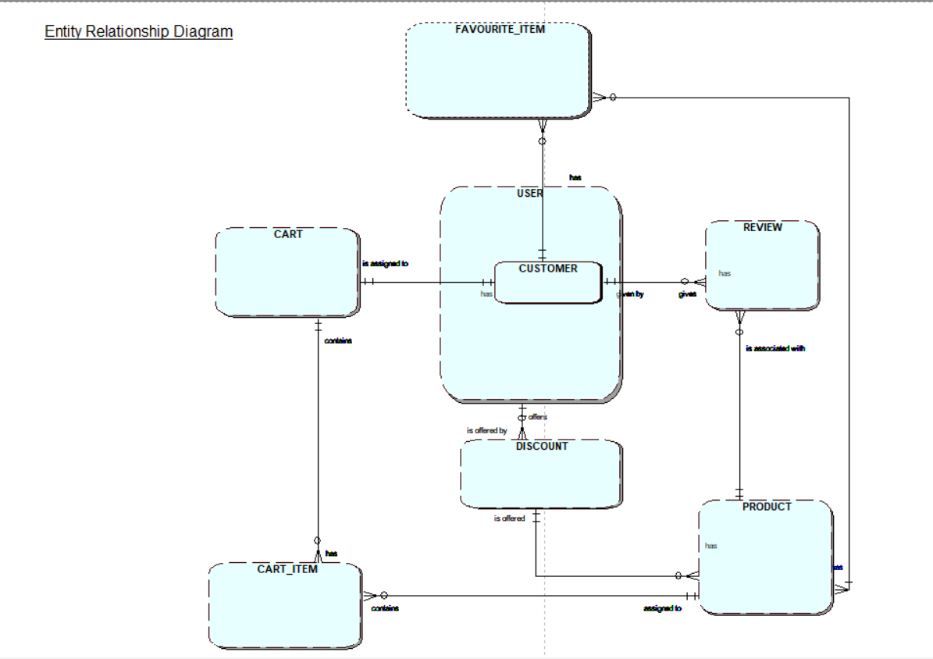
CUSTOMER RELATION

Slide 23
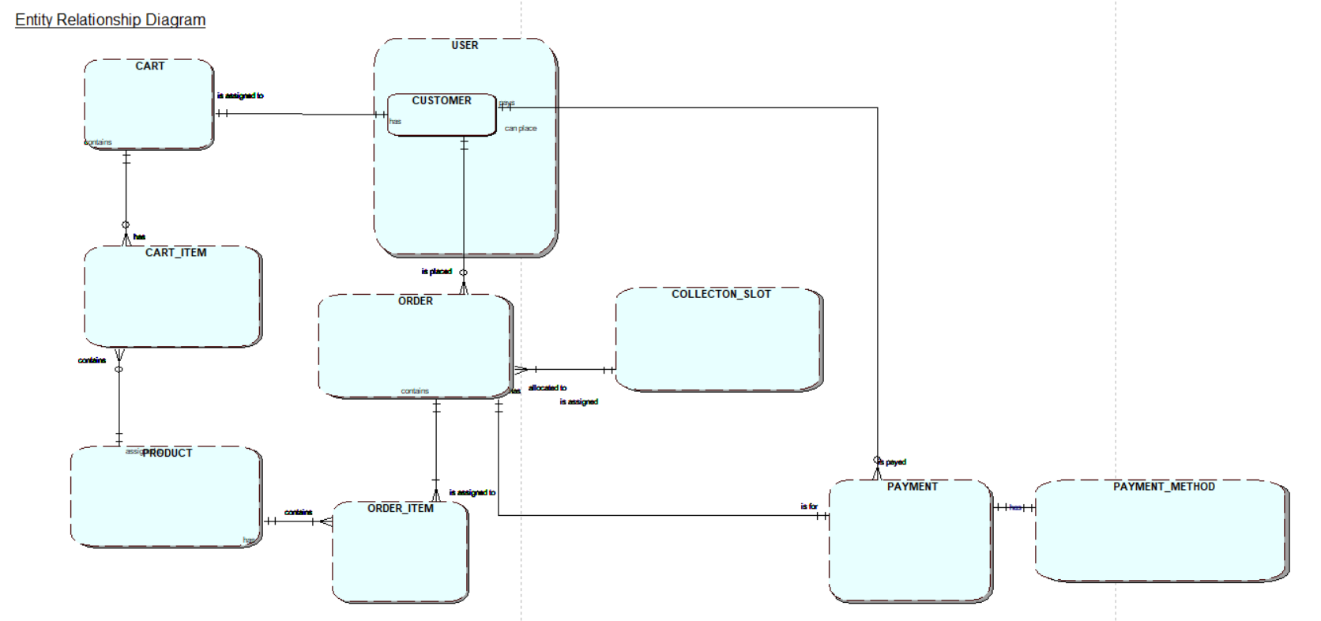
CUSTOMER RELATION

Slide 24
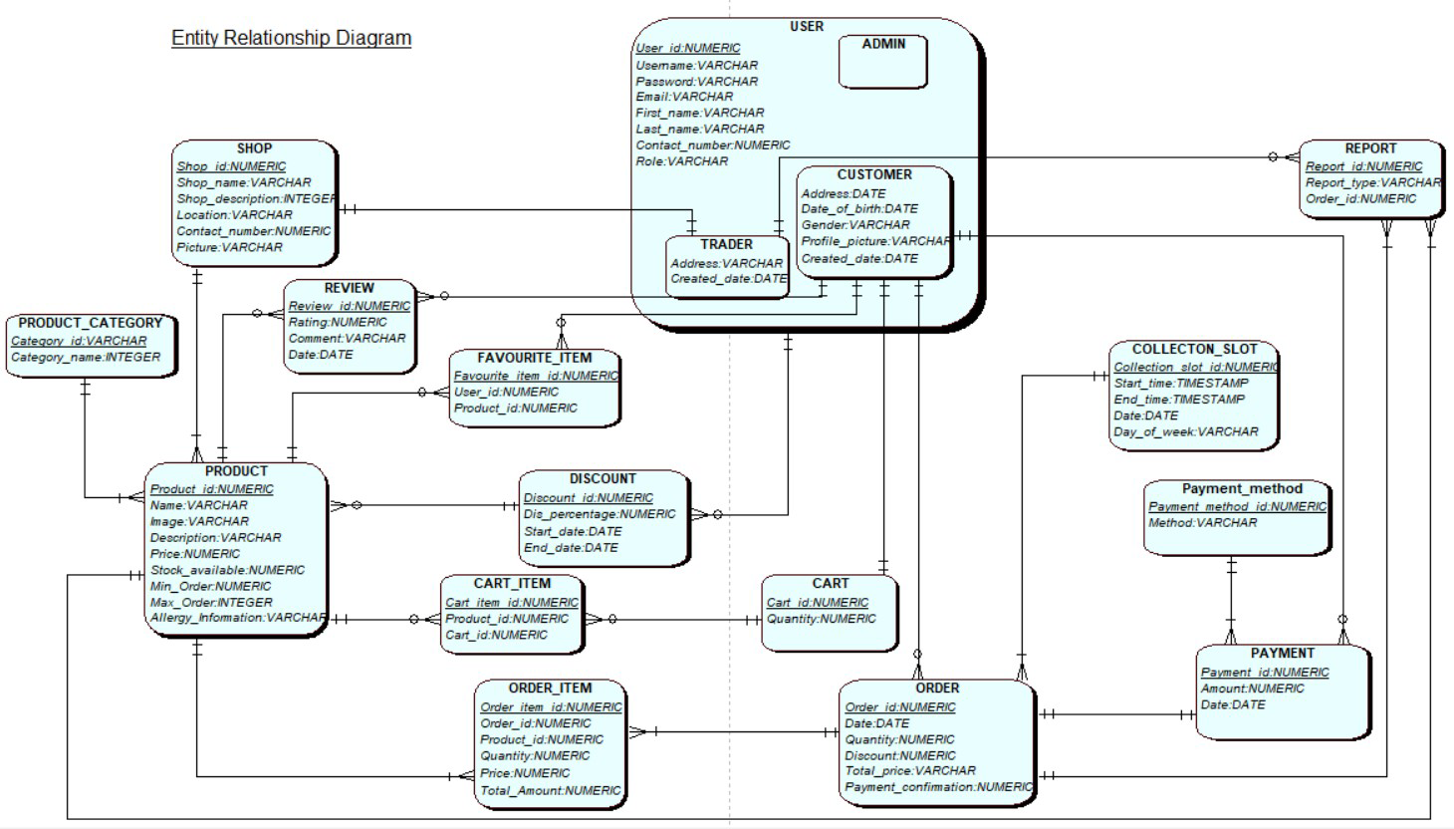
COMPOSITE ERD

Slide 25
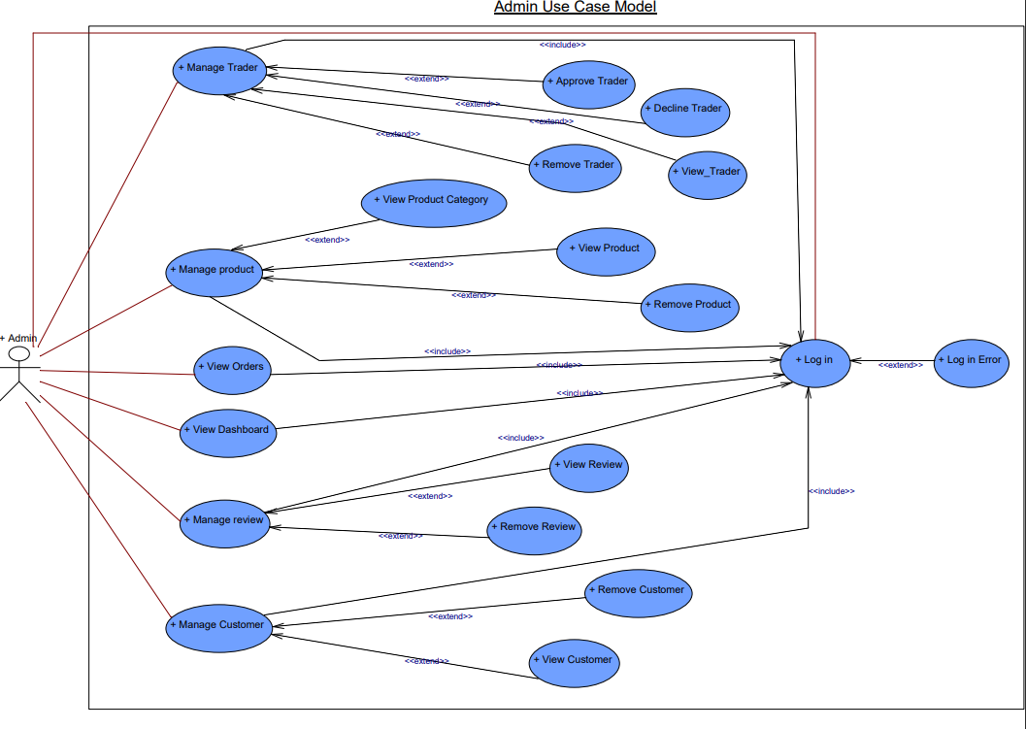
ADMIN USE CASE DIAGRAM

Slide 26
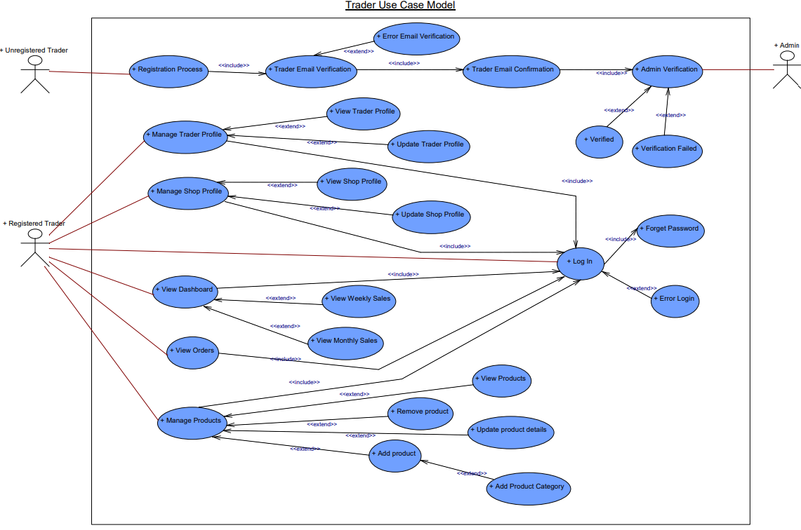
TRADER USE CASE DIAGRAM

Slide 27
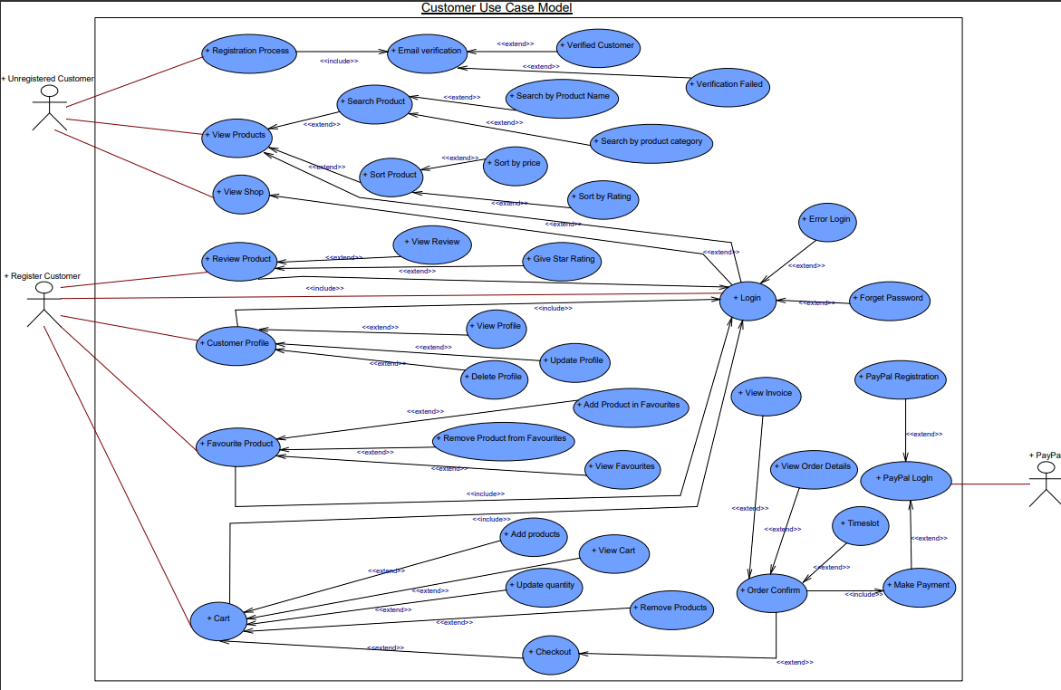
CUSTOMER USE CASE DIAGRAM

Slide 28
Website Demonstration
Customer Interface
Trader Interface
Admin Interface
28

Slide 29
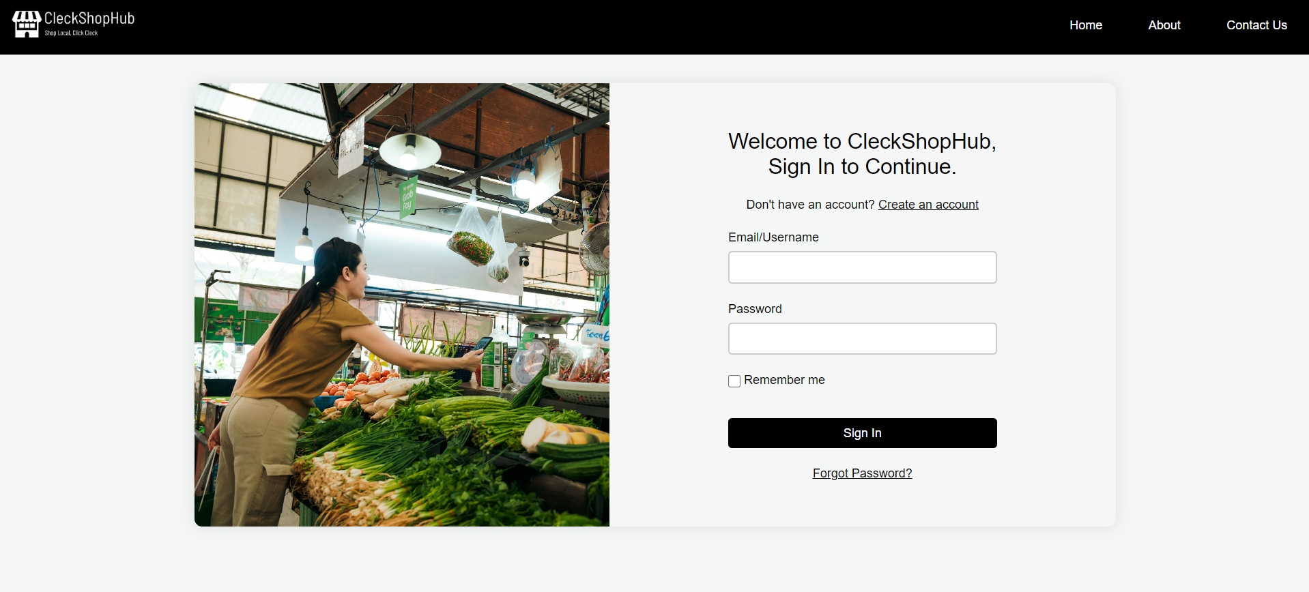
LOGIN PAGE

Slide 30
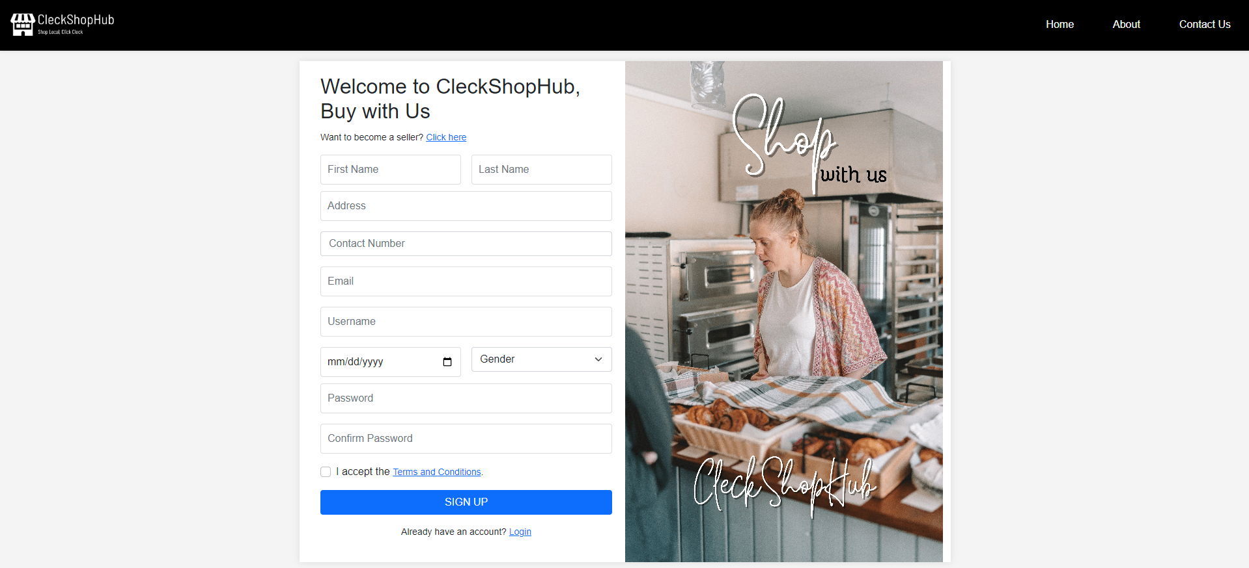
SIGN UP PAGE

Slide 31
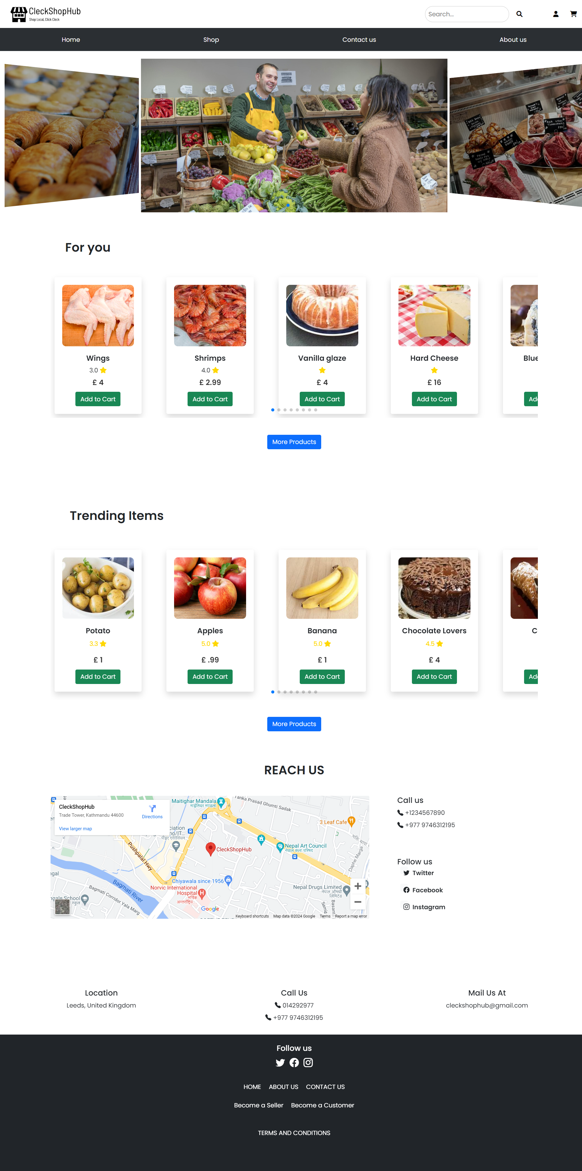
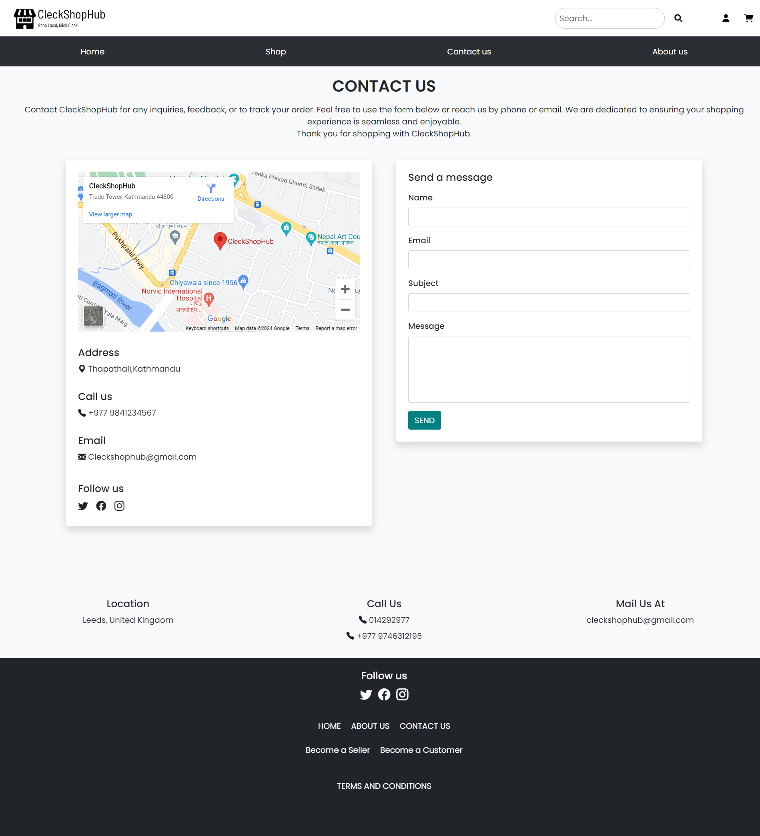
USER PAGES

Slide 32
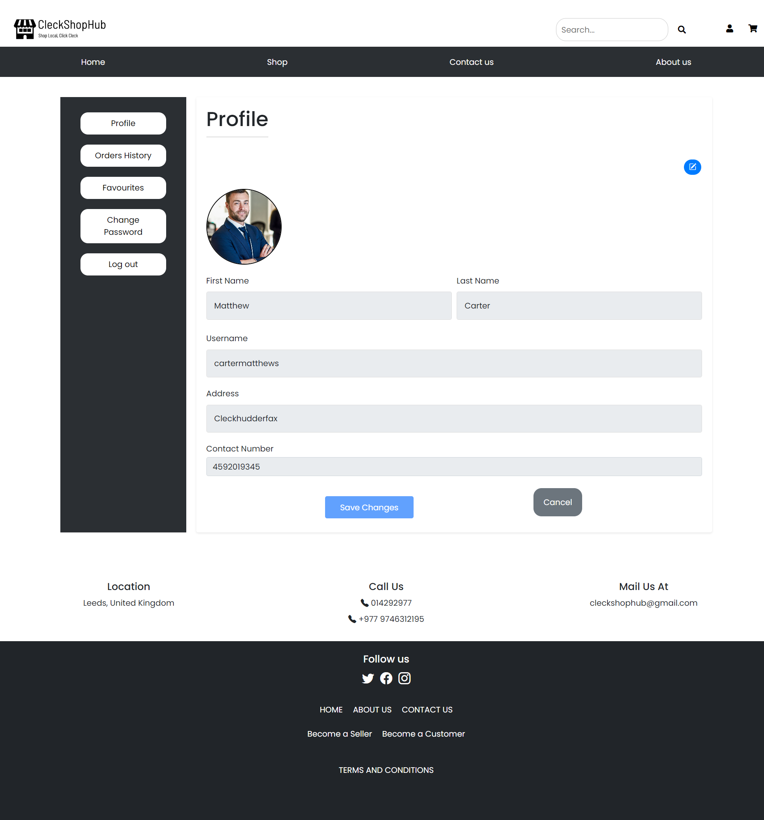
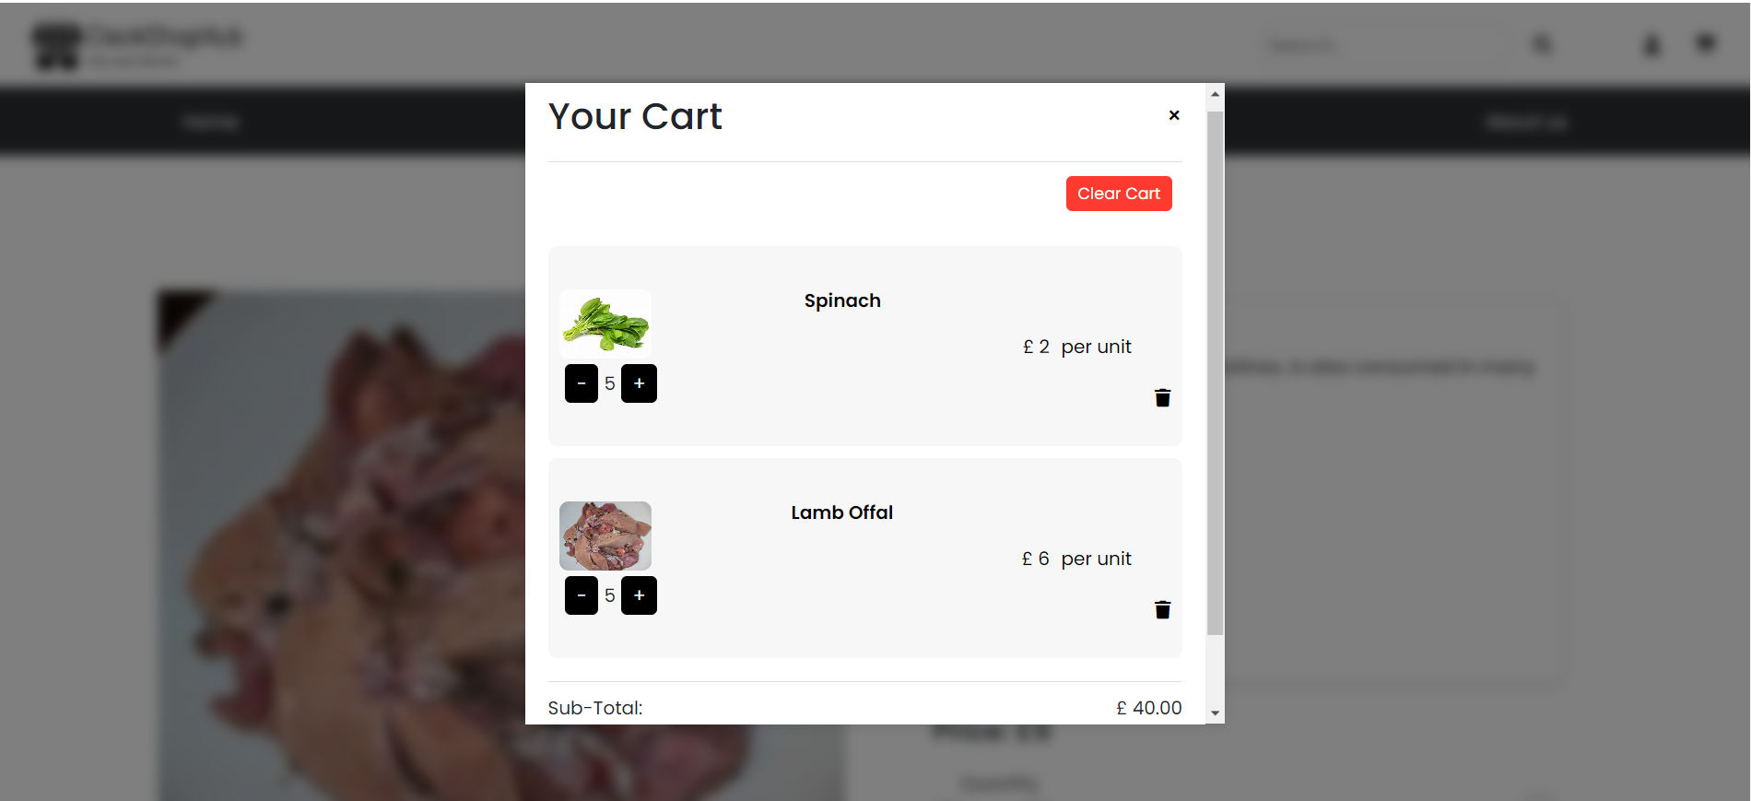
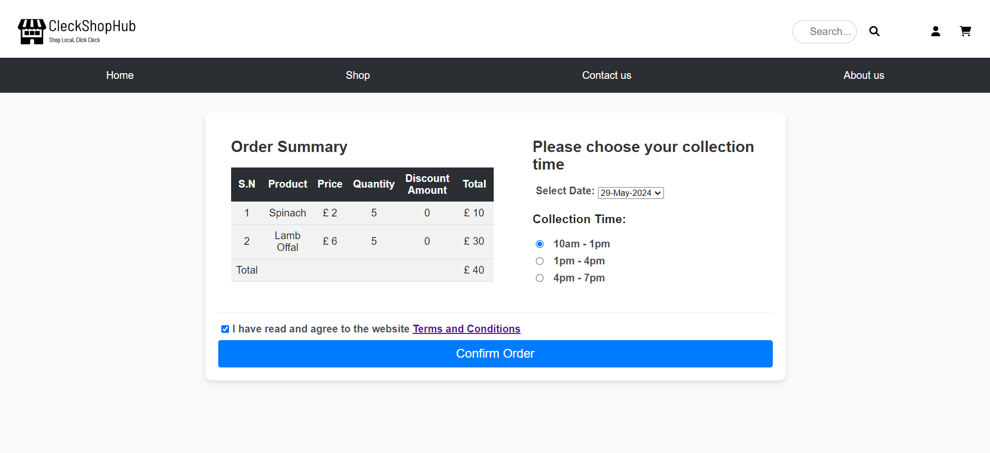
Customer Interface

Slide 33
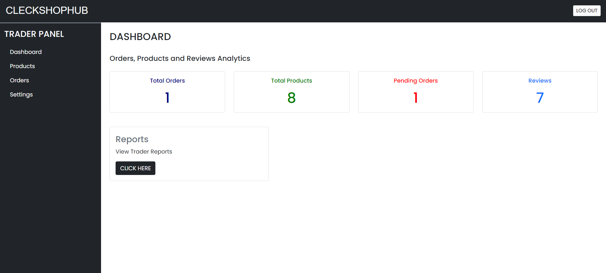
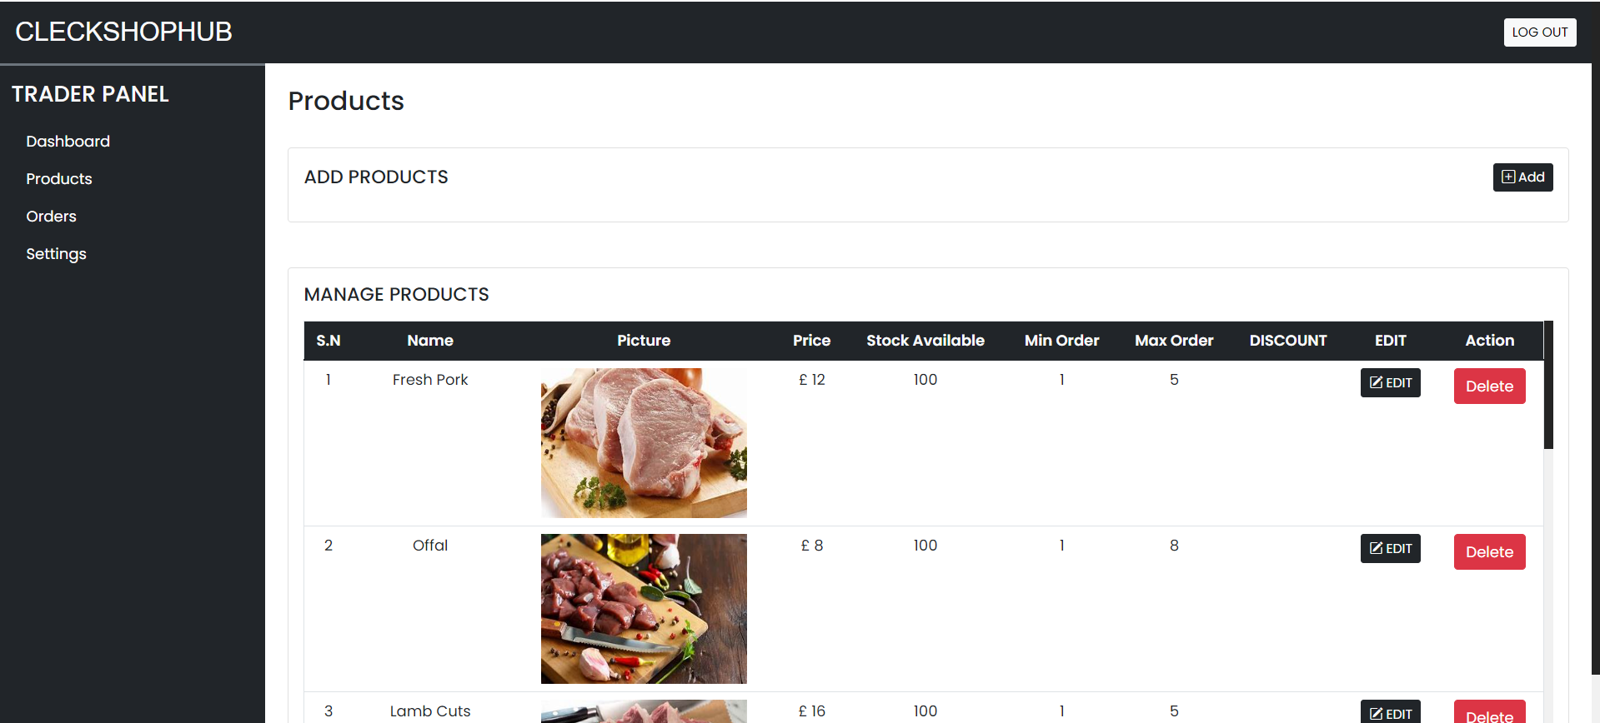
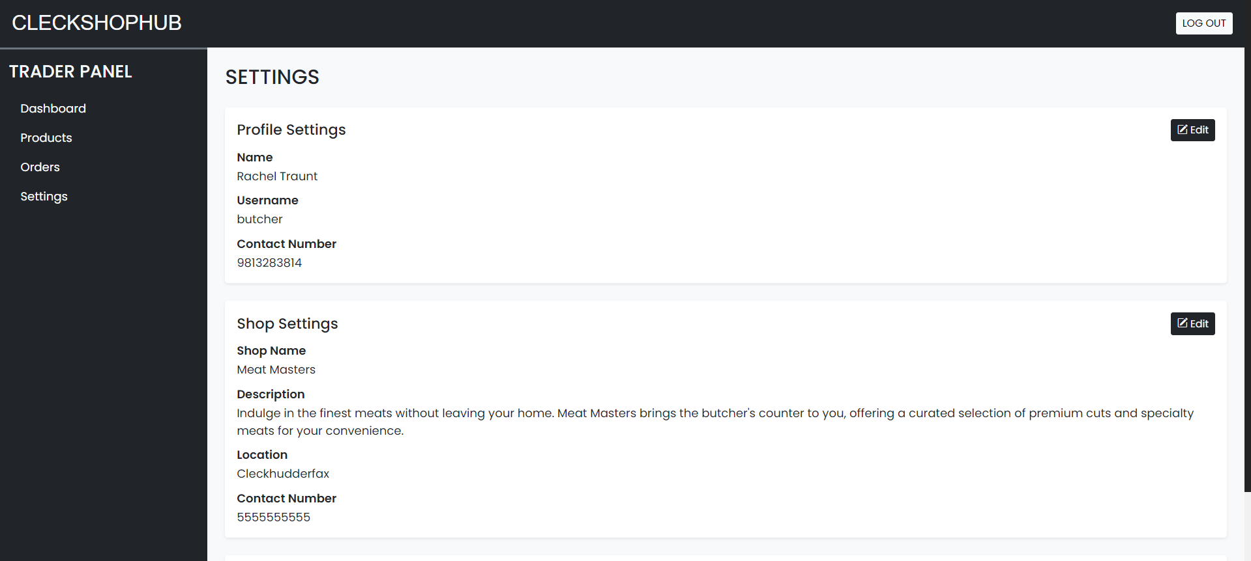
Trader Interface

Slide 34
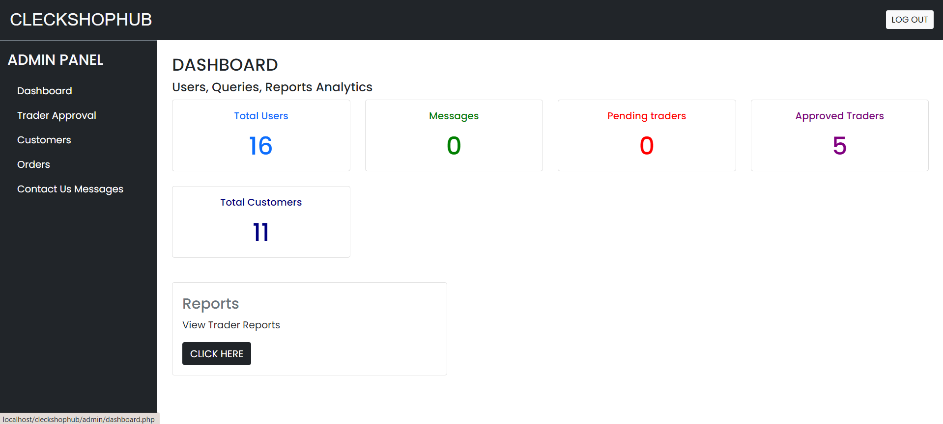
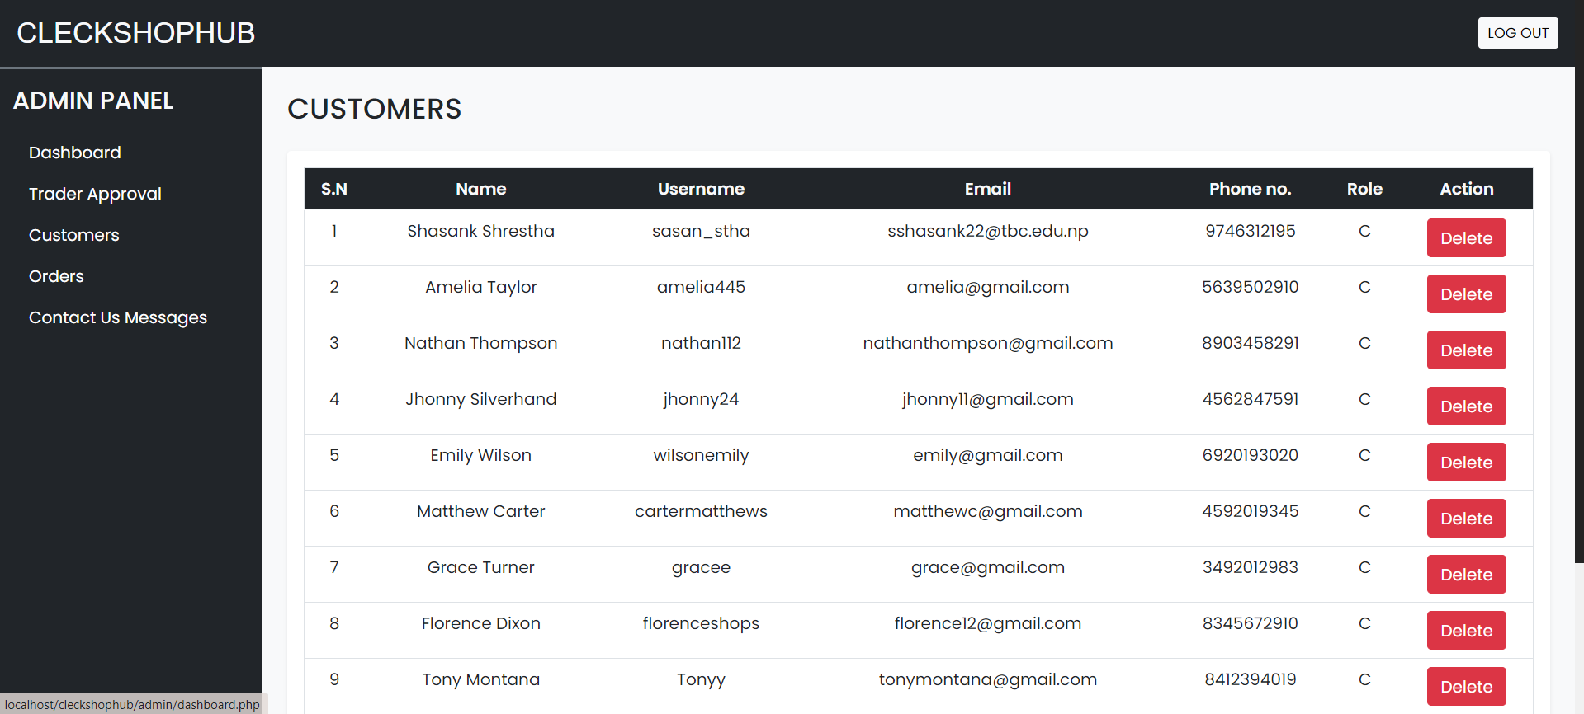
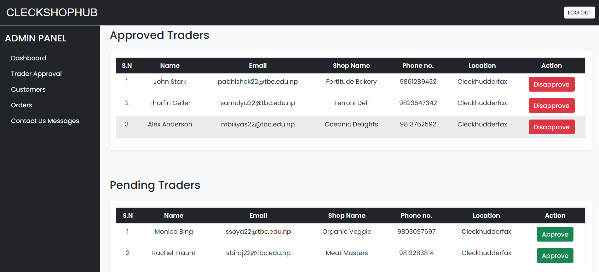
Admin Interface

Slide 35
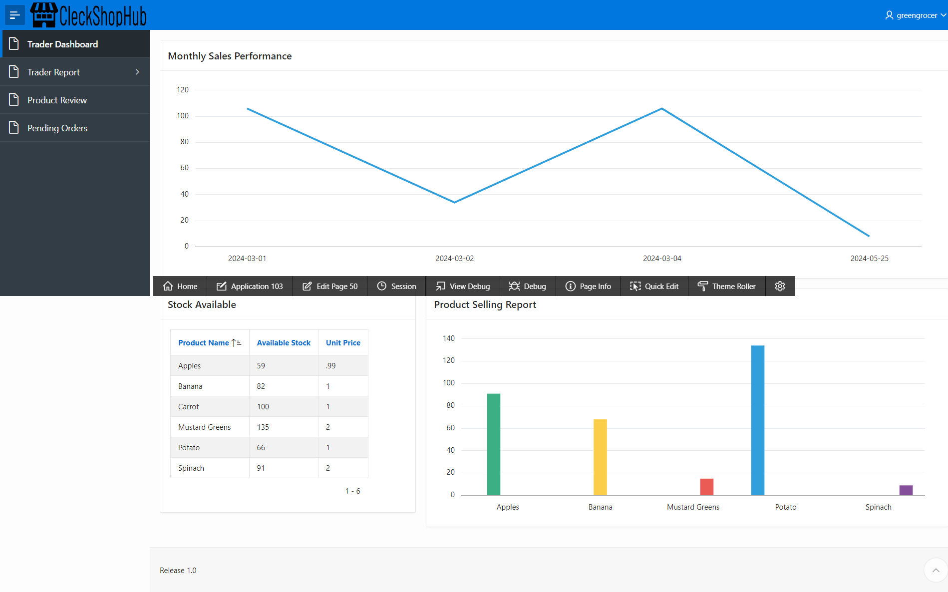
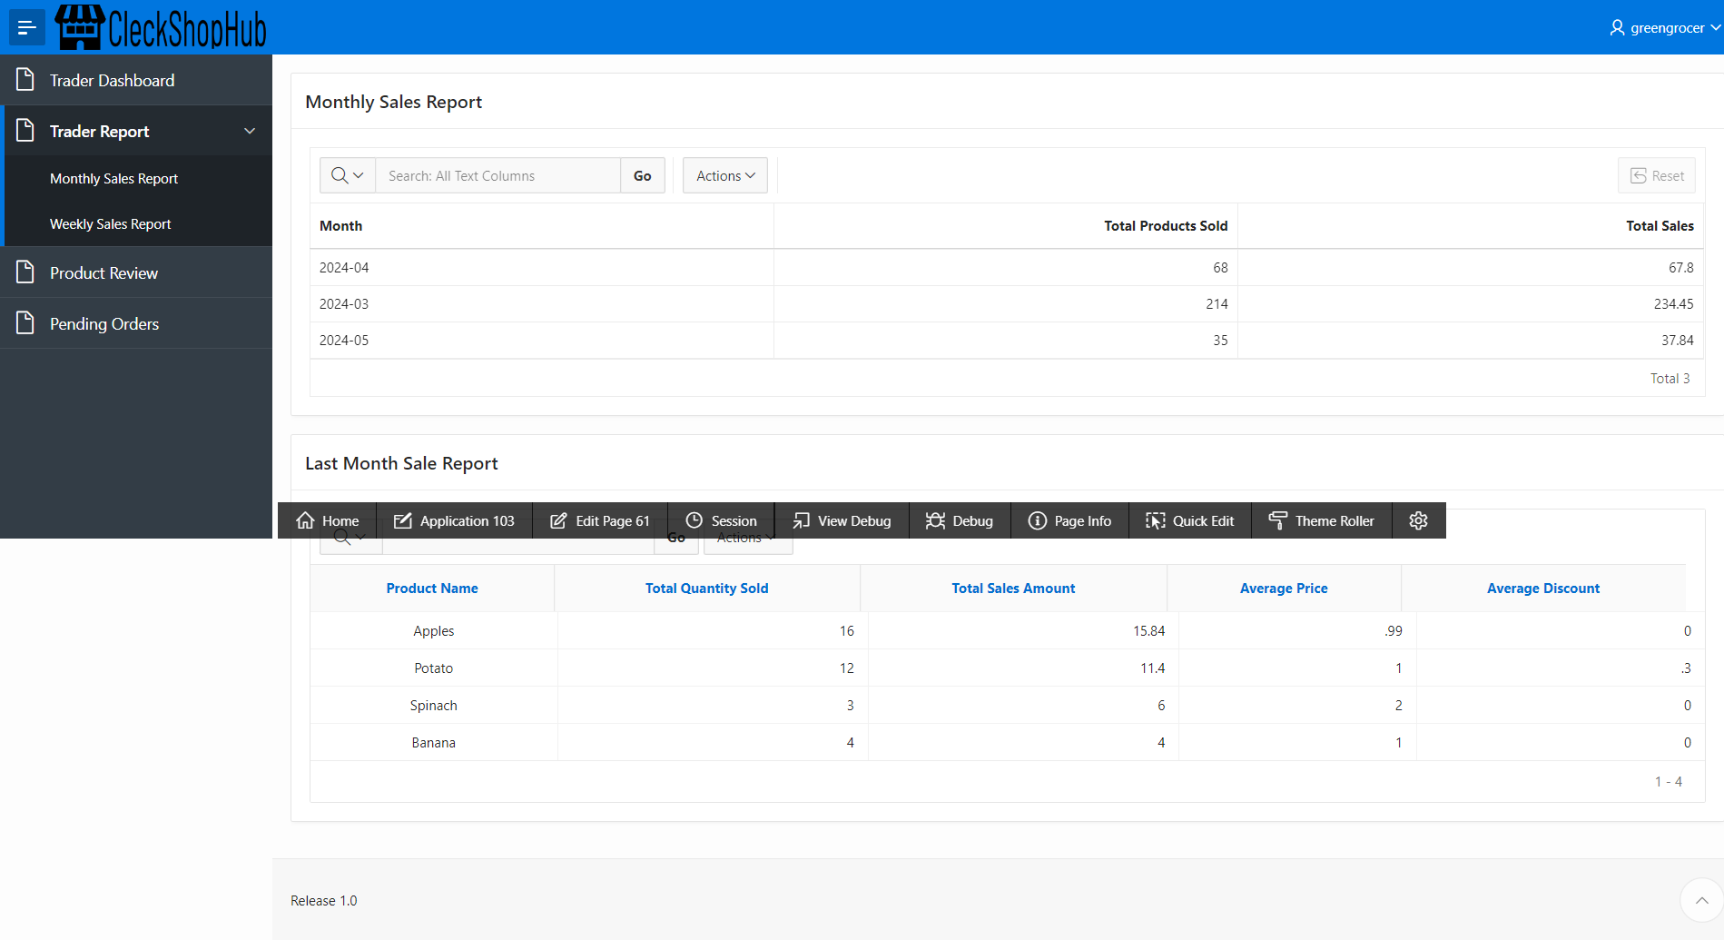
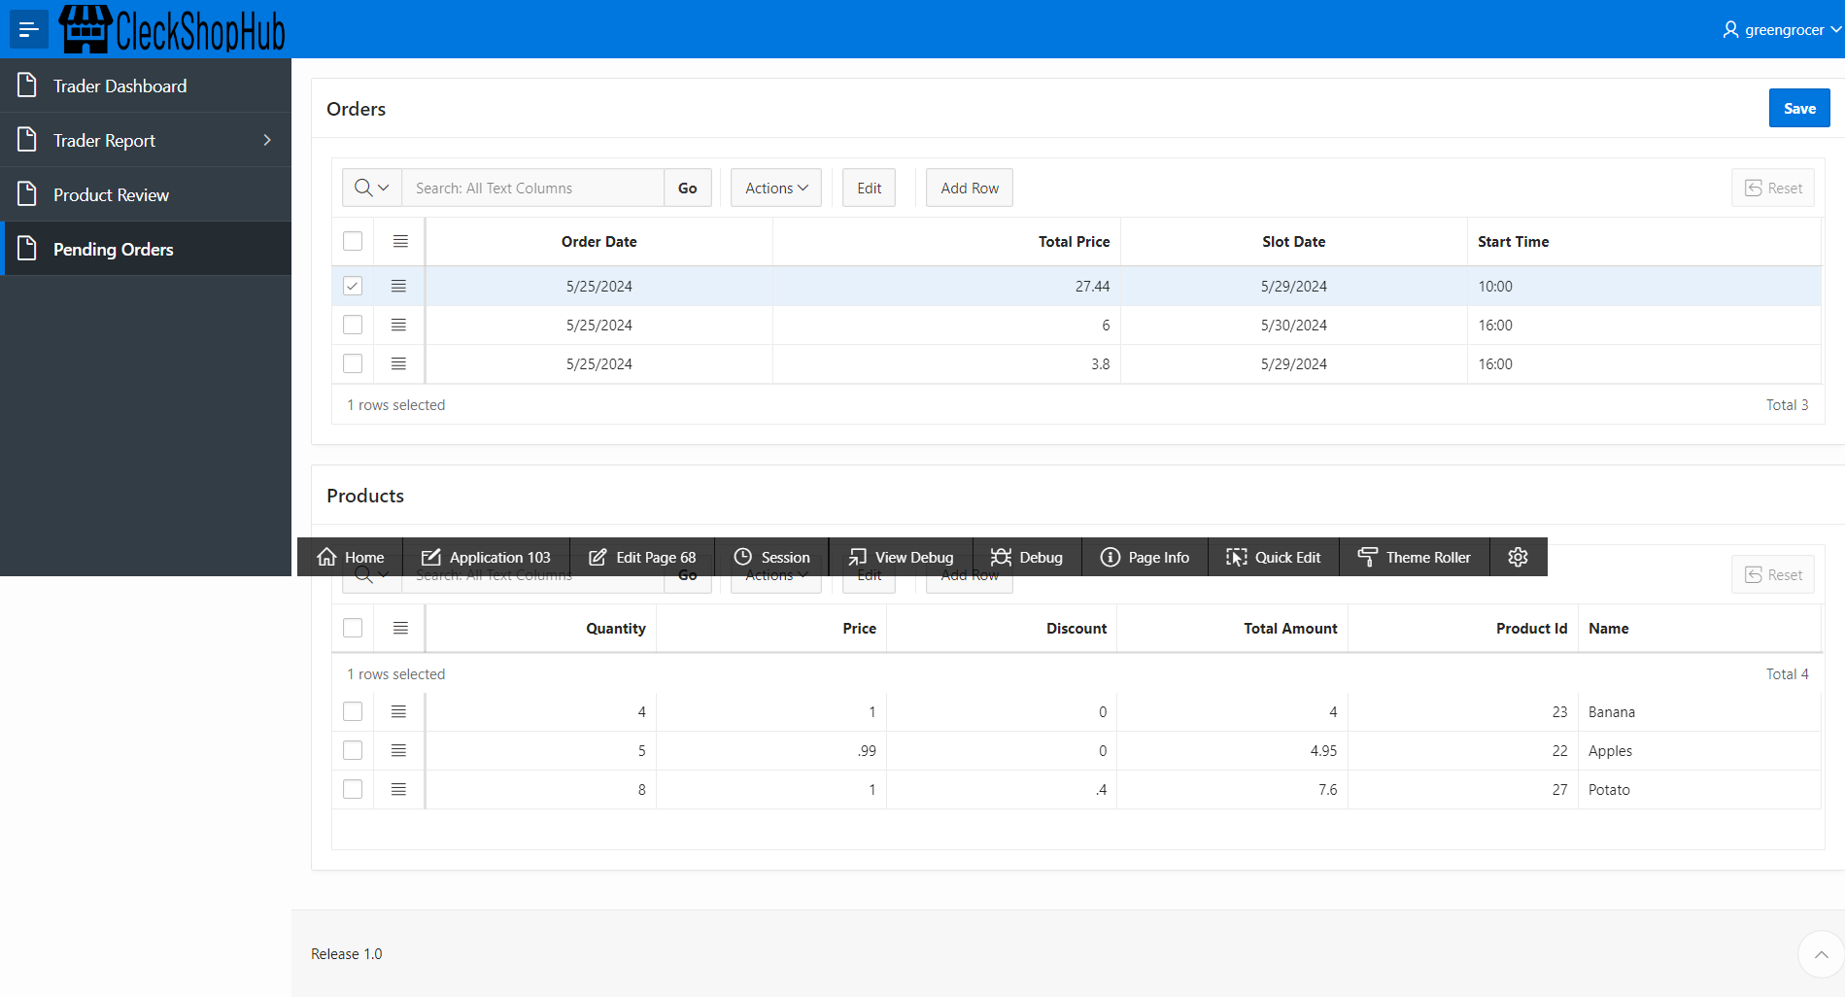
Trader Apex

Slide 36
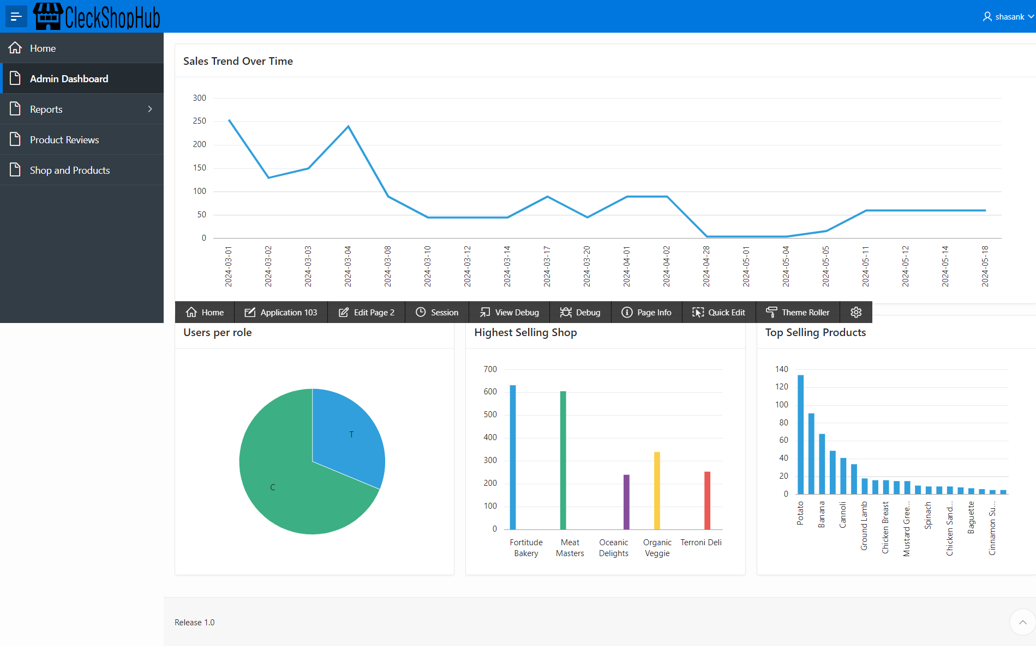
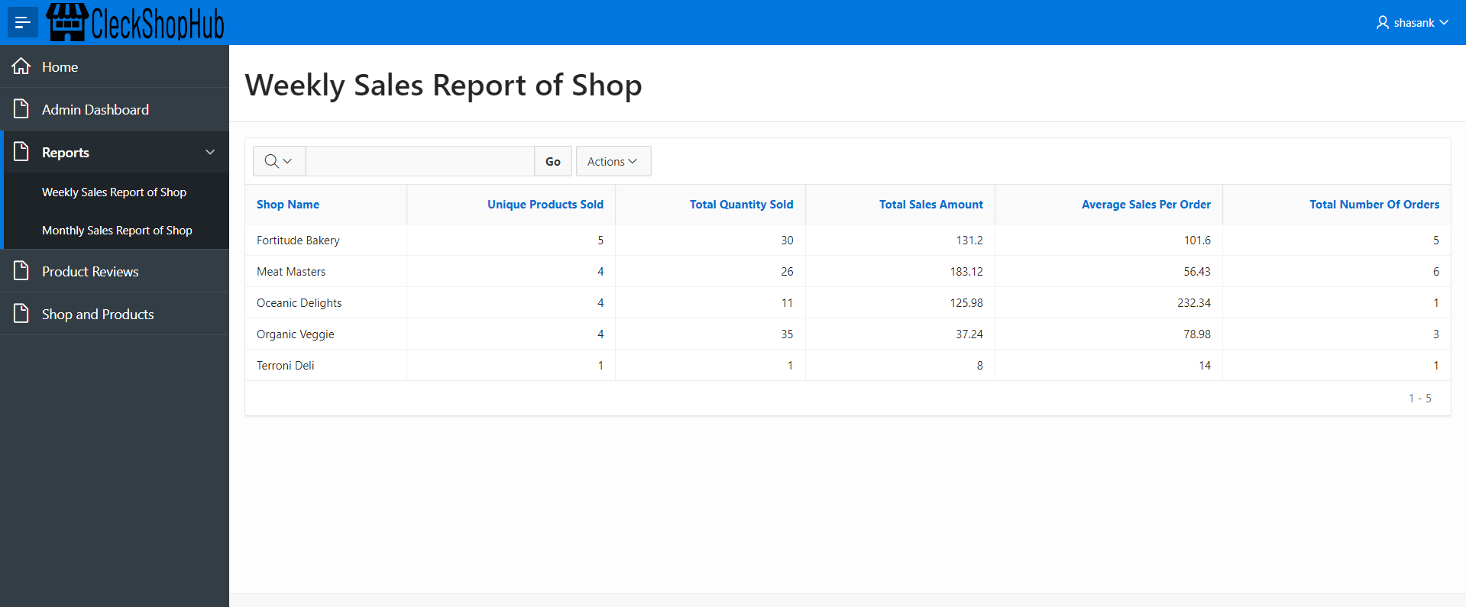
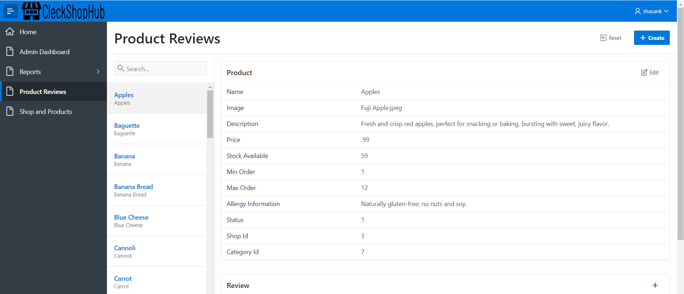
Admin Apex

Slide 37




Thank you !

